Slide 1
Food Automated Service Technology for Order and Delivery (FASTOD)
A presentation by Satwik Basu, Debargha Biswas, Koustav Roy
under the supervision of Mr. Sujoy Mondal
[Group-6]

Slide 2
What is FASTOD?
An easier way to pay for your food
An efficient way to conduct transactions
No need to wait in long queues anymore
Say goodbye to taking orders one by one
A relief from messing up your orders
An environment friendly alternative
Take as much time as you need before you order
Reduce paper waste and increase convenience

Slide 3
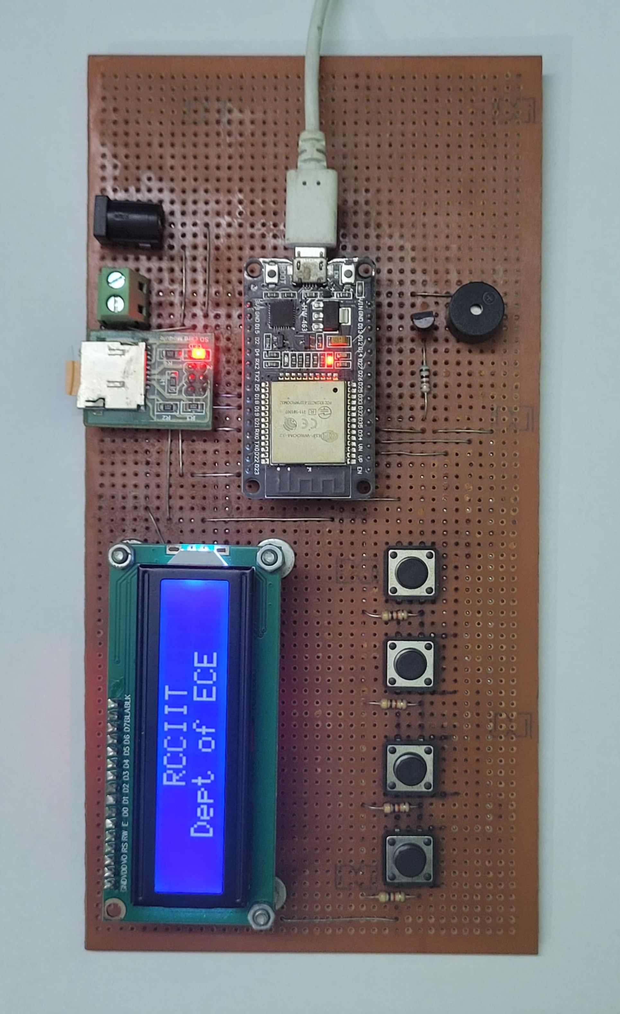
How does FASTOD work?
To give a brief idea about the working, we can divide the automation process in three steps:
Login: The customer connects their mobile device to the local Wi-Fi setup by the shop and they are prompted to open a webpage hosted by the ESP-32 dev board.
Ordering: The customer selects the dishes they want to order from the menu provided by the vendor on the website and clicks on submit once they have added everything they need to their cart.
Feedback: A token number is generated and displayed to the customer on their device while the same token number is stored into a .csv file and saved to the memory chip.

Slide 4

Working in Detail
Accessing vendor website using router
Website is hosted by the dev board and accessed by connecting to the router wi-fi
The website is customized according to the menu of the shop
Items can be added into cart and there will be organized subcategories
The submit button will generate a token number for order identification

Slide 5

Working in Detail
Generating and storing token
Once the order is submitted through the website, a token number is generated and displayed to the customer
The same token number is displayed on the LED screen of FASTOD as an indication of a new order being placed
Items ordered will be saved along with the token number in a .csv file in the memory chip attached with the module

Slide 6

Working in Detail
Miscellaneous functions
The buttons under the LED can be used to access the contents of the .csv file and displayed on the LED
The contents of the .csv file can be modified through the physical buttons such as deleting the entire database
The button can be used to delete the particular entry for which the order is ready
The LED will print a message to indicate which order token is completed and delivered

Slide 7
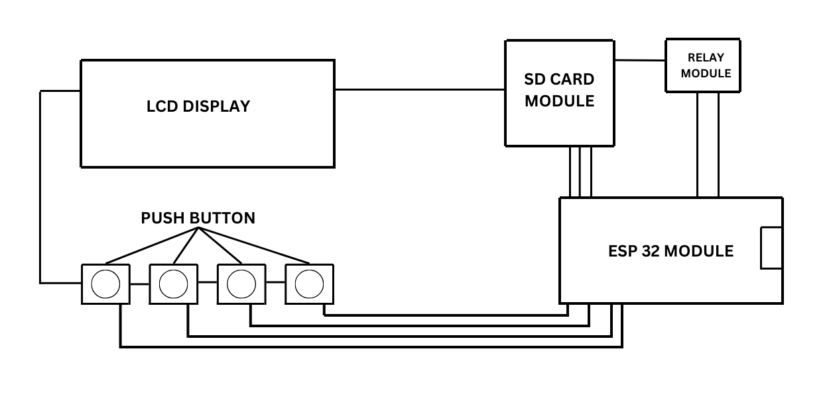
Schematic of the circuit board

Slide 8
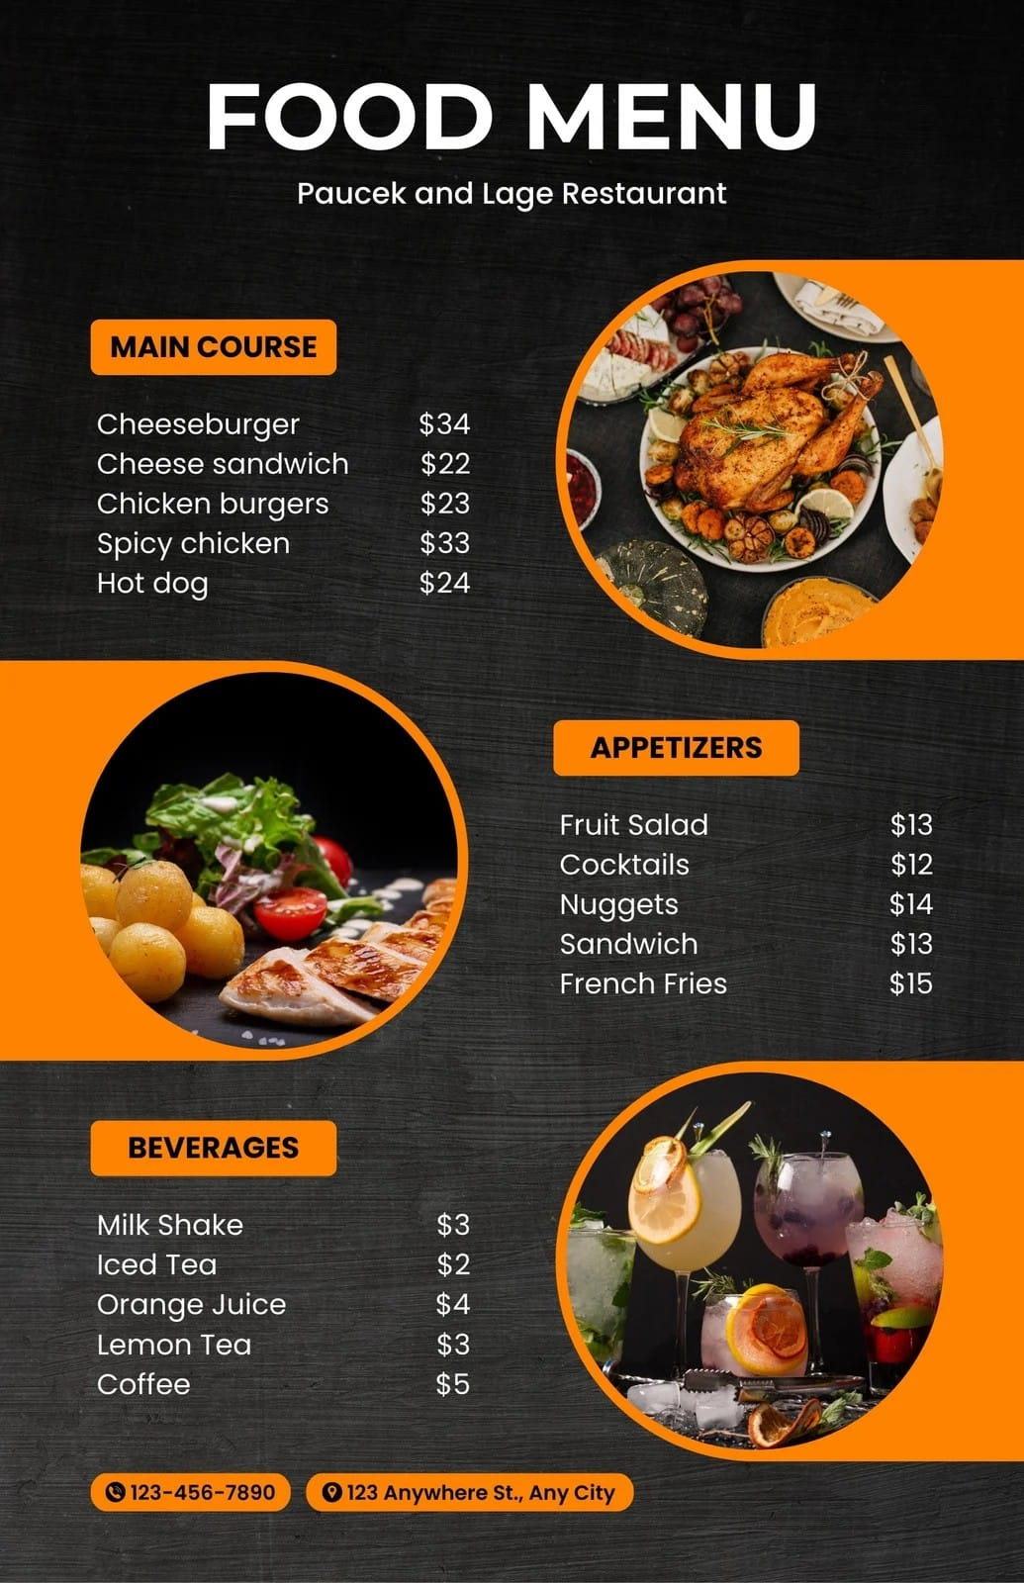
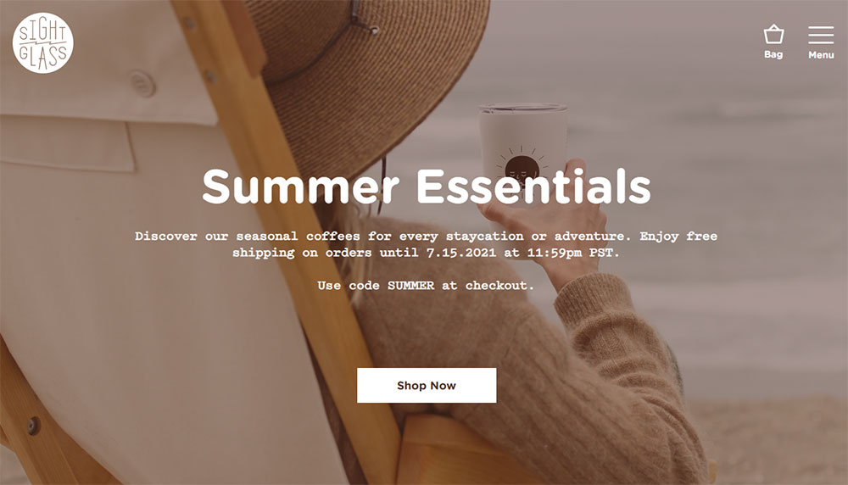
Sample Menu from Vendor
Sample Website Layout

Slide 9
Components and their functions
ESP-32 Dev Board
I2C LED
Memory Chip Module
The brains of the operation. It controls all the other components, stores the data and hosts the website in real-time
The brains of the operation. It controls all the other components, stores the data and hosts the website in real-time
The display unit of the FASTOD module. It displays the current status or relevant message about the order
It allows the ESP-32 board to use a bigger capacity storage device in order to host the website and store the necessary data generated
Barrel Jack
Physical Buttons
Buzzer
It is the port through which power is supplied to the whole board using a 5V adapter and USB-type A to type B cable
They serve various miscellaneous functions to modify the data stored and to help display appropriate message
Produces various sounds to indicate the status of the FASTOD module

Slide 10
Why use FASTOD?
Helps reduce manual errors that might creep into the process of ordering from small shop vendors that run on minimal staff
Design a system that enables users to place food orders easily without middle-man interaction by using unique token IDs to save the data of the order
Automate the food ordering process based on user selections
Implement a user-friendly interface with an LCD display
Provide feedback through the LED and a buzzer for user interaction.
Displaying current order directly to chefs through LCD display
Optionally, integrate the system with the internet for remote management and menu updates.

Slide 11
Future Scope
Mobile App Integration
Customer-facing mobile apps would enable menu browsing, remote ordering, and potentially even real-time order tracking. This fosters convenience and personalized experiences, potentially increasing customer satisfaction and loyalty.
Real-Time Features
Dynamic menus that update based on real-time inventory data, ensuring advertised items are readily available. Additionally, customer feedback collected through the app can provide valuable insights into preferences and trends, allowing restaurants to optimize their offerings.
Data-driven Marketing: The system's ability to collect anonymized customer data offers valuable insights into ordering patterns and customer preferences. Restaurants can leverage this data for targeted marketing campaigns, sending personalized promotions and special offers to specific customer segments

